Slide 1



Computer Vision for Autonomous Vehicles: Perception, Calibration, and Depth Estimation
DSA0202- COMPUTER VISION USING OPEN CV
Presented by:
JAASIEL J.S
Guided by:
DR. M. MAYURANATHAN

Slide 2
INTRODUCTION
Autonomous vehicles use Computer Vision to perceive and navigate their surroundings without continuous human control.
Computer Vision enables the detection of roads, pedestrians, vehicles, traffic signs, and lane markings in real time.
The system combines Vision Pipeline, Camera Calibration, and Depth Estimation to ensure accurate environmental perception.
Autonomous driving technology is widely used in self-driving cars, ADAS, robotaxis, and intelligent transportation systems.

Slide 3
Problem Statement
Road environments are highly dynamic, with changing traffic conditions, weather, and lighting affecting vehicle perception.
Accurate detection of pedestrians, vehicles, and traffic signs is essential to ensure safe and reliable autonomous navigation.
Uncalibrated cameras and inaccurate depth estimation can lead to incorrect distance measurements and unsafe driving decisions.
A robust Computer Vision system is required to provide real-time perception, obstacle detection, and intelligent decision-making.

Slide 4
VISION PIPELINE
Image Acquisition – Captures real-time road images using vehicle-mounted cameras.
Image Preprocessing – Enhances image quality by reducing noise and improving visibility.
Feature Extraction – Identifies important features such as lanes, edges, pedestrians, and traffic signs.
Object Detection & Classification – Detects and classifies vehicles, pedestrians, road signs, and other obstacles.
Decision Support – Provides processed information to the autonomous driving system for safe navigation.

Slide 5
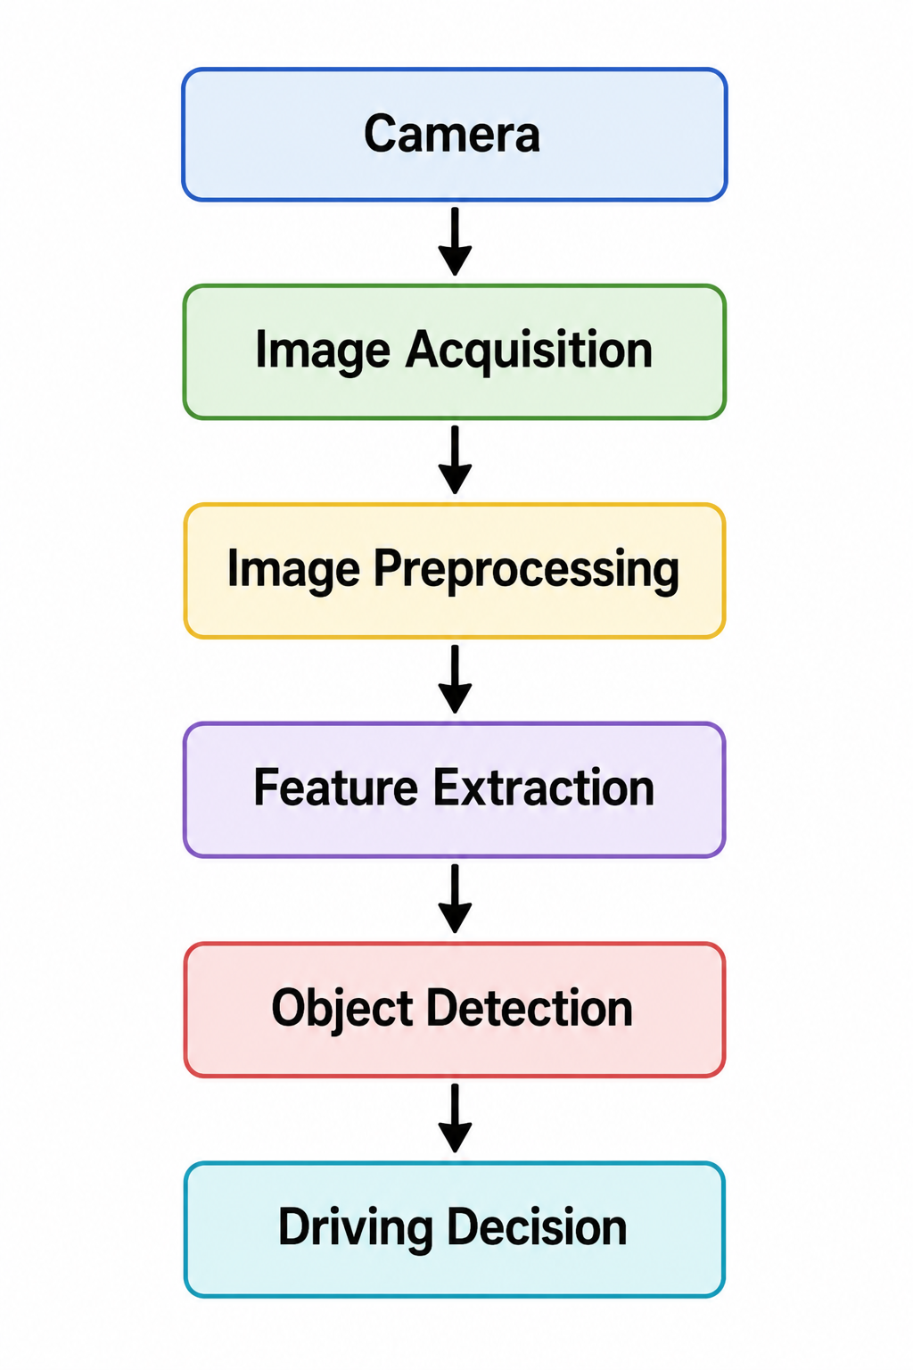

Slide 6
Camera Calibration
Camera Calibration determines the camera's intrinsic and extrinsic parameters for accurate image measurement.
Intrinsic Parameters define the camera's focal length, optical center, and lens characteristics.
Extrinsic Parameters define the camera's position and orientation relative to the real world.
Lens Distortion Correction removes image distortions to improve detection accuracy.
Calibration ensures precise object localization and distance measurement for safe autonomous driving.

Slide 7
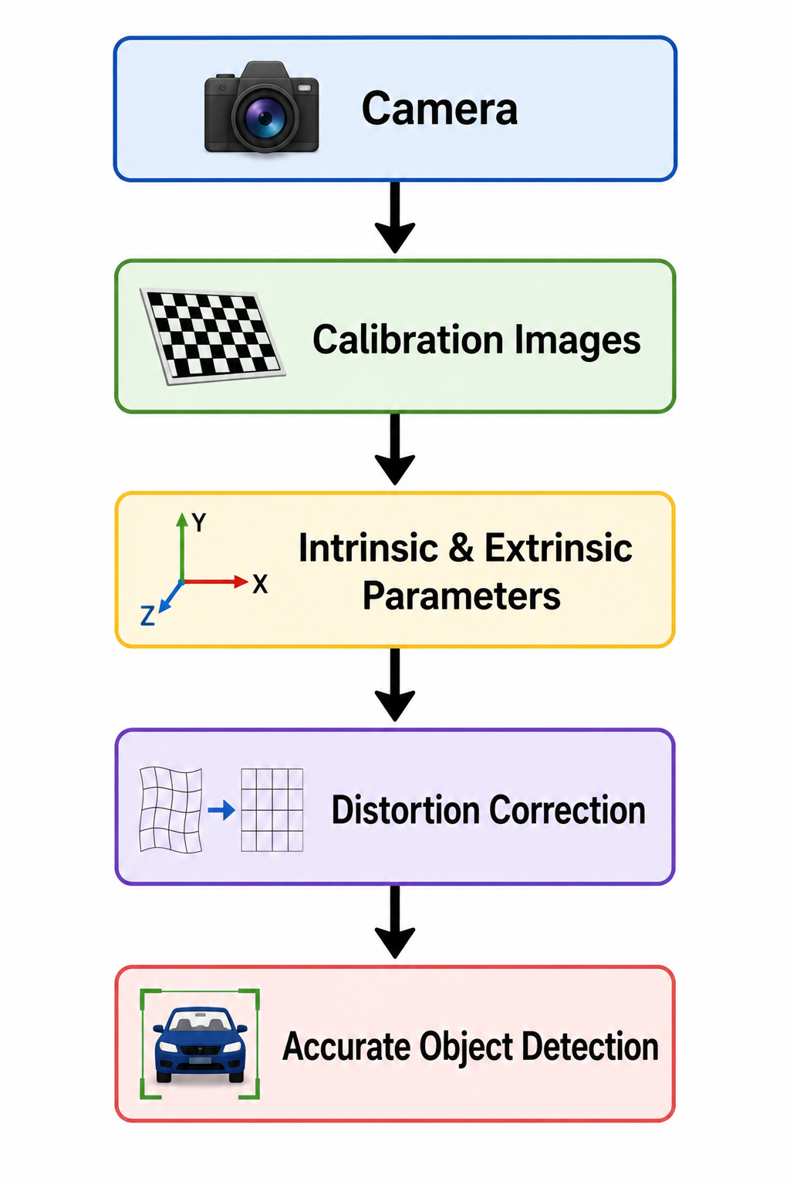

Slide 8
Depth Estimation
Depth Estimation calculates the distance between the autonomous vehicle and surrounding objects.
Stereo Cameras capture the same scene from two different viewpoints to estimate depth.
Disparity Matching identifies corresponding points in both images to measure pixel differences.
Triangulation converts disparity information into accurate real-world distances.
Depth information enables obstacle avoidance, collision prevention, and safe navigation.

Slide 9
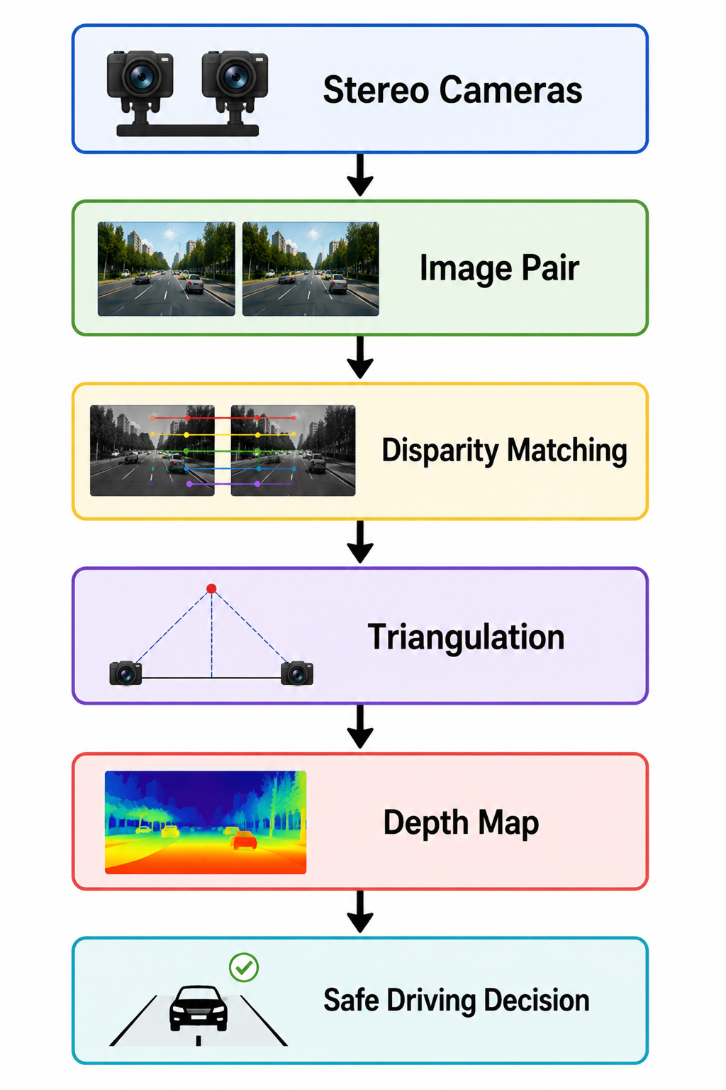

Slide 10
Integrated Working of an Autonomous Vehicle
The camera captures real-time road images and sends them to the perception system.
The Vision Pipeline preprocesses the images and detects roads, pedestrians, vehicles, and traffic signs.
Camera Calibration corrects distortions and provides accurate geometric measurements.
Depth Estimation calculates the distance to surrounding objects for collision avoidance.
The autonomous system makes intelligent driving decisions such as braking, steering, or accelerating safely.

Slide 11
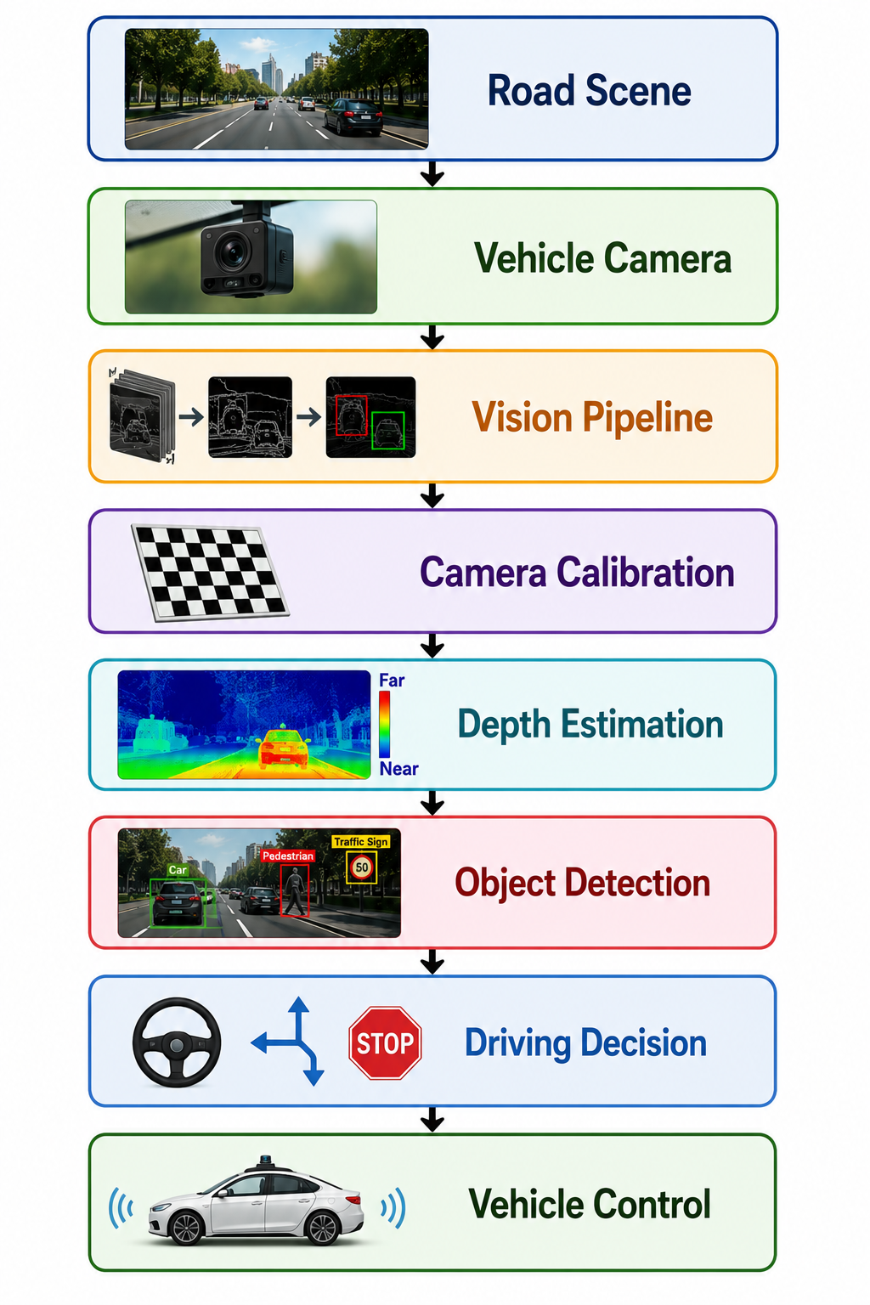

Slide 12
CONCLUSION
Computer Vision plays a vital role in enabling autonomous vehicles to perceive and understand their surroundings. By integrating the Vision Pipeline, Camera Calibration, and Depth Estimation, the system can accurately detect roads, pedestrians, and traffic signs while making safe driving decisions. As AI and computer vision technologies continue to advance, autonomous vehicles will become more intelligent, reliable, and efficient for future transportation.

Slide 13


